Slide 1


Graph Homomorphism Revisited for Graph Matching
Wenfei Fan Shuai Ma Yinghui Wu
University of Edinburgh
Jianzhong Li Hongzhi Wang
Harbin Institute of Technology

Slide 2
Graph Matching: the problem
Given graphs G₁ and G₂ , decide whether G₁ matches G₂ .
Applications
  Web mirror/Web site classification
  Complex object identification
  Plagiarism detection
  Social matching, key work search, proximity search, web service composition…
How to define?
Widely employed in a variety of emerging real life applications
Notes:
Nan Tang: in the takeaway message, I won’t use two “application” s, you can use “Wide employed, used, etc”

Slide 3
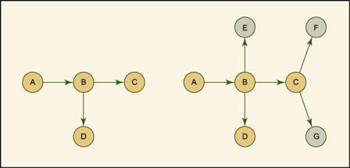
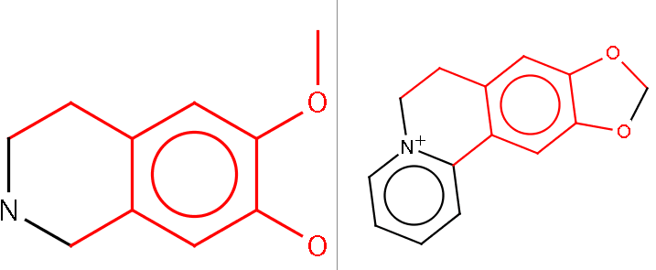
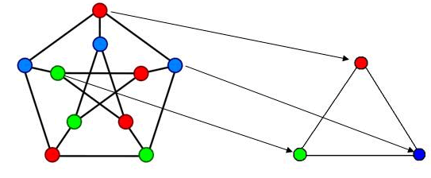
Graph similarity metrics: the state of the art
Structural-based metrics
  Graph homomorphism
  Subgraph isomorphism
  Maximum common subgraph
  Edit distance
  Graph simulation
Capable enough?
Identical label matching, edge-to-edge mappings/relations

Slide 4
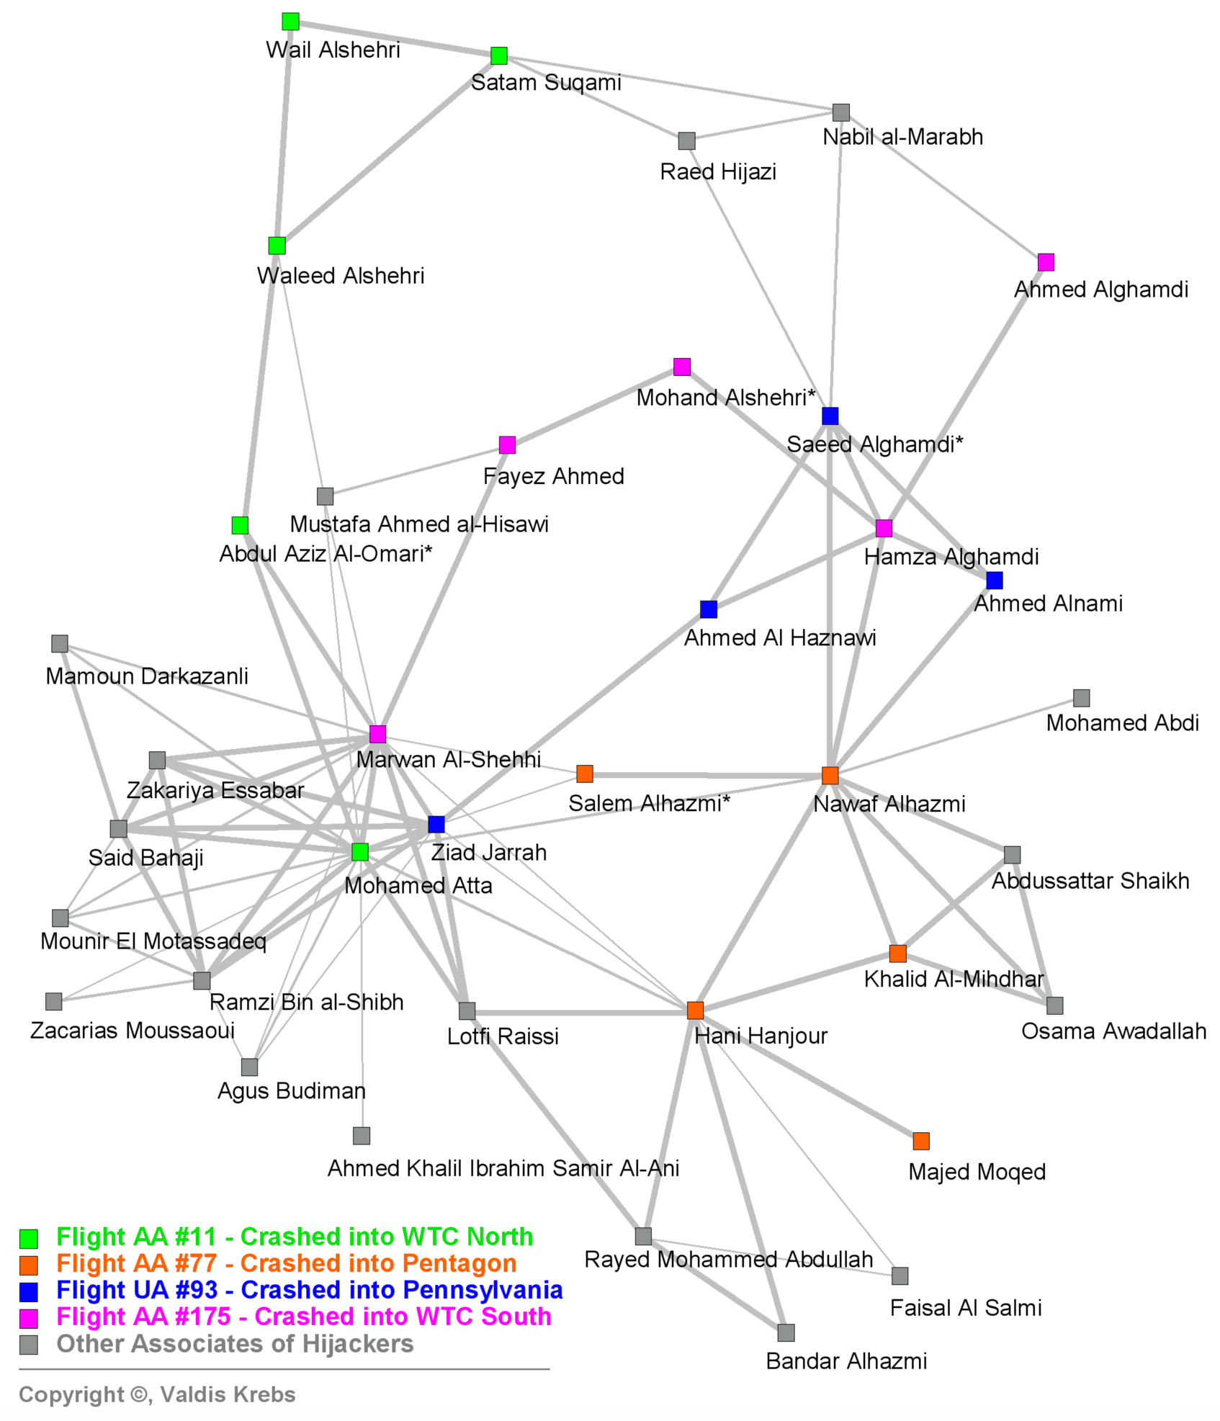
Terrorist network matching: real life application (1)
“Those who were trained to fly didn’t know the others. One group of people did not know the other group.” (Bin Laden)
Very long mean path length of 4.75 for a network less than 20 nodes [1].
Edge-to-edge mappings is often an overkill
Notes:
Nan Tang: please highlight the “mean path length”, since at the first time, I did not follow the sentence
In takeaway message: “mappings is” should be “mappings are” or “mapping is”

Slide 5




















Website matching: real life application
edge-to-path
mappings
A.Home
B.Index
books
sports
digital
books
audio
categories
booksets
DVDs
CDs
textbooks
abooks
albums
G₁
arts
school
audio books
features
genres
G₂
albums
Graph homomorphism (subgraph isomorphism) is too restrictive!

Slide 6
Outline
Revisions of graph homomorphism
  (1-1) P-Homomorphism: node similarity, edge-to-path mapping
Graph matching as optimization problems
  Metrics for measuring graph similarity
    Maximum cardinality and overall similarity
  Optimization problems and complexity results
Approximating graph matching
  Performance guarantees
  Approximation algorithm
Experimental Study
Conclusion
A first step towards revising conventional notions of graph matching
Notes:
Sometimes you use “edge to path”, and sometimes “edge-to-path”, better to uniform them

Slide 7
Basic notations
    G = (V, E, L) , labeled directed graph
    Similarity matrix M over G₁ and G_{2,} a matrix of size |V₁||V₂|, with M(u,v) the similarity score of node u and v.
    Similarity threshold ξ
B.index
B.index
book
sports
digital
A.home
book
sports
digital
A.home
A.Home | B.Index | 0.7
books | books | 1.0
abooks | audiobooks | 0.8
books | booksets | 0.6
textbooks | school | 0.6
albums | albums | 0.85
categories
bookset
CD
DVD
books
audio
categories
bookset
CD
DVD
books
audio
textbook
arts
arts
school
school
audiobooks
audiobooks
features
features
genres
textbook
album
genres
album
abook
albums
abook
albums
Enriched model for capturing semantic similarity

Slide 8
P-Homomorphism
P-homomorphism from G₁ to G₂: a total mapping from V₁ to V₂
  preserves node similarity (w.r.t a similarity matrix M and threshold ξ)
  map edges to nonempty paths
P-homomorphism v.s graph homomorphism
  node similarity v.s label equality
  edge-to-path mapping v.s edge-to-edge mapping
P-hom ?
A.home
B.index
A
B
C
A
B
A
A
A
books
audio
book
sports
digital
E
C
categories
D
bookset
CD
DVD
textbook
album
D
D
D
B
C
B
C
C
arts
school
audiobooks
features
genres
abook
G₃
G₄
G₁
G₂
Graph homomorphism is a special case of P-homomorphism
albums

Slide 9
1-1 P-Homomorphism
G₁ is 1-1 P-homomorphism to G₂ if there exists a 1-1 (injective) P-homomorphism from G₁ to G₂.
  distinct nodes in V₁ have distinct matches in V₂
1-1 P-homomorphism v.s subgraph isomorphism
  node similarity v.s label equality
  1-1 edge-to-path mapping v.s bijective edge-to-edge mapping
1-1 P-hom ?
A.home
B.index
A
A
A
A
A
book
sports
digital
books
audio
C
B
B
D
v₁
v₂
categories
bookset
CD
DVD
B
textbook
album
D
B
E
C
B
C
C
arts
D
E
abook
G₅
school
audiobooks
features
genres
G₁
G₂
G₆
albums
Subgraph isomorphism is a special case of 1-1 P-homomorphism

Slide 10
Metrics for measuring graph similarity
Not every node in one graph can find P-hom matches in the other graph …
Maximum cardinality
  The cardinality of p-hom mapping from a subgraph G₁’ = (V₁’, E₁’,L₁’) of G₁ to G₂:
    Card(ρ) = |V₁’|/|V₁|
The maximum cardinality problem CPH (resp. CPH¹⁻¹):
  Input: two graphs G₁ and G₂
  Output: the P-hom (resp. 1-1 P-hom) mapping ρ having the maximum Card(ρ).
MCS is a special case of CPH¹⁻¹
Similarity metric based on the maximum number of nodes

Slide 11
Example for CPH¹⁻¹
Maximum cardinality metric : 4/5 = 0.8
A
A
C
B
B
v₁
v₂
B
D
E
D
E
G₅
G₆

Slide 12
Metrics for measuring graph similarity (cont.)
Overall similarity
  The overall similarity of p-hom mapping from a subgraph G₁’ of G₁ to G₂:
    Sim(ρ) = ∑(w(v₁’) * M(v₁’, ρ(v₁’)) / ∑w(v), v₁’ ∈V₁’, v ∈ V
Maximum overall similarity SPH (resp. SPH¹⁻¹):
  Input: two graphs G₁ and G₂
  Output: the P-hom (resp. 1-1 P-hom) mapping ρ having the maximum Sim(ρ) .
Similarity metric based on overall weighted similarity of nodes

Slide 13
Example for CPH and SPH
Maximum overall similarity metric : (1*1+6*1)/8 = 0.7
A
A
0.6
C
B
B
1.0
v₁
v₂
B
6
D
E
D
E
G₅
G₆

Slide 14
Complexity results - Intractability
Intractability
  P-Hom and 1-1 P-Hom are NP-complete.
    NP-hard when both G₁ and G₂ are acyclic directed graphs (DAGs)
    NP-hard for 1-1 P-Hom when G₁ is a tree and G₂ is a DAG.
    reduction from 3SAT and X3C
  The decision problem of CPH, CPH¹⁻¹,SPH, SPH¹⁻¹ are NP-complete.
    reduction from P-Hom and 1-1 P-Hom
    NP-hard for DAGs
Approximation
algorithms?
P-Hom and 1-1 P-Hom are intractable.

Slide 15
Complexity results – Approximation Hardness
Approximation hardness
  Unless P = NP, CPH, CPH¹⁻¹, SPH, SPH¹⁻¹ are not approximable within O(1/n^{1-ε}) for any constant ε, with n the node number of input graphs.
  Approximation factor preserving reduction (AFP-reduction) from maximum weighted independent set problem (MWIS)
P-Hom and 1-1 P-Hom are hard to approximate

Slide 16
Approximation Algorithms
Given two graphs G₁ = (V₁, E₁, L₁) and G₂ = (V₂, E₂, L₂), CPH, CPH¹⁻¹, SPH, SPH¹⁻¹ are all approximable within
  O(log² (|V₁||V₂|)/ (|V₁||V₂|))
AFP reductions to MWIS problem
Problems | Complexity | Approximation complexity
P-hom | NP-complete | ─
1-1 P-hom | NP-complete | ─
CPH | NP-complete | Approximation-hard
CPH¹⁻¹ | NP-complete | Approximation-hard
SPH | NP-complete | Approximation-hard
SPH¹⁻¹ | NP-complete | Approximation-hard
Approximation bound?
P-Hom can be solved with a provable performance guarantee

Slide 17
Approximation algorithm for CPH
Algorithm compMaxCard(G₁,G₂,M, ξ)
  Input: two graphs G₁ = (V₁, E₁, L₁) and G₂ = (V₂, E₂, L₂), a similarity matrix M, and a similarity threshold ξ
  Output: a P-hom mapping from subgraph of G₁ to G₂
  Key ideas
    initialize matching list for each node in G₁
    compute the transitive closure of G₂
    starting from a match pair, recursively choose and include new matches to the match set until it can no longer be extended, via a greedy strategy.
  Complexity: O(| V₁ |³| V₂ |² + | V₁ || E₁ || V₂ |³)
Avoid operations on
the product graph
P-Hom problems can be solved with a provable performance guarantee
Notes:
Below key ideas: “Start from a match pair, recursively chooses”, there are some problems of “Start” and “chooses”, either two verbs, or miss sth…

Slide 18
Algorithm compMaxCard: running example
A.home
B.index
books
audio
book
sports
digital
categories
bookset
CD
DVD
textbook
album
abook
school
art
audiobooks
features
genres
G₁
G₂
albums

Slide 19
Algorithm compMaxCard: running example (cont.)
candidate set w.r.t M and ξ
A.home
B.index
books
audio
book
sports
digital
categories
bookset
CD
DVD
textbook
album
abook
school
art
audiobooks
features
genres
G₁
G₂
albums
Step1: Initialize matching list for each node in G₁

Slide 20
Algorithm compMaxCard: running example (cont.)
A.home
B.index
books
audio
book
sports
digital
categories
bookset
bookset
CD
DVD
textbook
album
abook
school
art
audiobooks
features
genres
G₁
G₂
albums
Step2: Pick a node and select a pair of match

Slide 21
Algorithm compMaxCard: running example (cont.)
A.home
B.index
books
audio
book
sports
digital
categories
categories
bookset
CD
DVD
textbook
textbook
album
school
abook
school
art
audiobooks
features
genres
G₁
G₂
albums
Step3: recursively expanding matches

Slide 22
Algorithm compMaxCard: running example (cont.)
A.home
B.index
books
audio
book
sports
digital
categories
bookset
CD
DVD
textbook
album
school
art
audiobooks
features
genres
abook
audiobooks
abook
G₁
G₂
albums
Step3: recursively expanding matches

Slide 23
Algorithm compMaxCard: running example (cont.)
A.home
B.index
books
audio
book
sports
digital
categories
bookset
CD
DVD
textbook
album
abook
school
art
audiobooks
features
genres
G₁
G₂
albums
final result: a P-hom from G₁ to G₂

Slide 24
Experimental Study
Investigate the ability and scalability of the approximation algorithms vs graph simulation, subgraph isomorphism, and vertex similarity
Datasets
  Real-life data: Websites in online stores, international organizations and online newspaper
  Synthetic data: graph generator controlled by the number of nodes m, and noise%
Experimental Setting
  Graph size
    Web graphs and skeletons
    Synthetic graph size
  Matching threshold: 0.75
  Accuracy and efficiency
Web Sites | Web graphs G(V,E,L)
 | # of nodes | # of edges | avgDeg(G) | maxDeg(G)
Site 1 | 20,000 | 42,000 | 4.20 | 510
Site 2 | 5,400 | 33,114 | 12.31 | 644
Site 3 | 7,000 | 16,800 | 4.80 | 500
Web Sites | Skeleton 1 (α = 0.2) |  | Skeleton 2 (top-20)
 | # of nodes | # of edges | # of nodes | # of edges
Site 1 | 250 | 10,841 | 20 | 207
Site 2 | 44 | 214 | 20 | 20
Site 3 | 142 | 4260 | 20 | 37

Slide 25
Experimental Study (cont.)
our methods find more than 50% of matches
Algorithms | Accuracy (%)
 | Skeleton 1 (α = 0.2) |  |  | Skeleton 2 (top-20)
 | Site 1 | Site 2 | Site 3 | Site 1 | Site 2 | Site 3
compMaxCard | 80 | 100 | 60 | 80 | 100 | 60
compMaxCard¹⁻¹ | 40 | 100 | 30 | 80 | 100 | 40
compMaxSim | 80 | 100 | 50 | 90 | 100 | 60
compMaxSim¹⁻¹ | 20 | 80 | 10 | 90 | 100 | 40
SF | 40 | 30 | 20 | 80 | 80 | 70
cdkMCS | N/A | N/A | N/A | 67 | 100 | 0
graph simulation finds no match
more matches on site 1 and 2 than site 3
more matches than SF and cdkMCS
P-Hom algorithms find more meaningful matches
P-Hom algorithms find more matches than 1-1 P-Hom algorithms
Notes:
“graph simulation find no …” should be “finds”

Slide 26
Experimental Study (cont.)
Our algorithms took less than 4 seconds
Algorithms | Scalability(seconds)
 | Skeleton 1 (α = 0.2) |  |  | Skeleton 2 (top-20)
 | Site 1 | Site 2 | Site 3 | Site 1 | Site 2 | Site 3
compMaxCard | 3.128 | 0.108 | 1.062 | 0.078 | 0.066 | 0.080
compMaxCard¹⁻¹ | 2.847 | 0.097 | 0.840 | 0.054 | 0.051 | 0.064
compMaxSim | 3.197 | 0.093 | 0.877 | 0.051 | 0.051 | 0.062
compMaxSim¹⁻¹ | 2.865 | 0.093 | 0.850 | 0.053 | 0.049 | 0.039
SF | 60.275 | 3.873 | 7.812 | 0.067 | 0.158 | 0.121
cdkMCS | N/A | N/A | N/A | 156.93 | 189.16 | 0.82
cdkMCS did not run to completion
SF is more sensitive to the graph size
P-Hom algorithms are more efficient and robust

Slide 27
Experimental Study (cont.)
Accuracy above 65%
Insensitive
P-Hom algorithms find matches with relatively high accuracy

Slide 28
Experimental Study (cont.)
P-Hom algorithms scale well with the size of graphs

Slide 29
Experimental Study (cont.)
Above 50%
Accuracy of P-Hom algorithms is sensitive to the noise

Slide 30
Experimental Study (cont.)
our algorithms are not sensitive to the noise
Graph simulation is sensitive to the noise
Efficiency of P-Hom algorithms are not sensitive to the noise

Slide 31
Conclusion
P-homomorphism and 1-1 P-homomorphism, revisions of graph homomorphism/subgraph isomorphism
  node similarity, edge-to-path mappings
  quantitative metrics to measure graph similarity
Complexity bounds of decision and optimization problems for P-hom and 1-1 P-hom
  Intractability
  Approximation hardness
Approximation algorithms with performance guarantees on match quality
Graph homomorphism revisited for graph matching

Slide 32
Future work
New application areas
Indexing and filtering techniques
Comparison of our work with feature-based approaches
Incremental graph matching problem
There is much more to be done

Slide 33
Terrorist Collaboration Network (1970 - 2010)
“Those who were trained to fly didn’t know the others. One group of people did not know the other group.” (Bin Laden)

Slide 34
  Approximation factor preserving reduction (AFP-reduction) from maximum weighted independent set problem (MWIS)
Problem A
Problem B
f
x
f(x)
g, α
g(x, S_{B} f(x), ε), α(ε)
S_{B} f(x), ε
Solution of X
Solution of f(X)

